Slide 1
Emergency Response Mapping Sphere
Team ERMS
Brandon Le, Kiet Nguyen, Hai Yen Nguyen, Antony Quach, Josh Wu

Slide 2
Problem Background
Emergency response operations require rapid, accurate situational awareness in hazardous environments.
First responders routinely enter dangerous, unfamiliar environments with limited visibility.
This increases the risk of injury, delayed rescue, and poor tactical decisions.
Existing technologies, such as drones, body-worn cameras, and robots often provide incomplete or unreliable information.
Current technologies do not sufficiently reduce operational risk due to impracticality to deploy in confined or chaotic events.
Notes:
First responders routinely enter dangerous and unfamiliar environments with limited situational awareness, increasing the likelihood of injury, delayed rescue, and poor tactical decision-making.
Existing technologies, such as drones, body-worn cameras, and robots are often not good enough for current situations, and do not significantly reduce risks for first responders.

Slide 3
Needs Statement
From 2018-2020, 87% of firefighter injuries occurred in structure fires. Active shooter incidents last only 12 minutes on average. There is a need for a device that first responders can use to ensure safety quickly in hazardous environments.
The Emergency Response Mapping Sphere needs improved sensing, mapping quality, and information delivery for reliable use in real-world emergency environments.
Current Limitations:
3D Mapping: Limited accuracy and resolution of the mapped out environment, reducing reliability of spatial information
Information Delivery: Data is not presented in an intuitive way, slowing decision-making under stress
https://www.usfa.fema.gov/statistics/reports/firefighters-departments/firefighter-injuries-v22i4.html
https://apps.usfa.fema.gov/pdf/efop/efo248128.pdf
Notes:
While a previously developed throwable environmental scanner has demonstrated the ability to improve situational awareness for first responders, significant limitations prevent effective use in real-world emergency environments. In particular, the sensing and camera modules in prior implementations perform poorly in low-visibility environments such as dark or smoke-filled spaces.
Additionally, current limitations in the accuracy and resolution of the generated 3D environment reduce the reliability of spatial information needed for informed decision-making. Inaccurate or incomplete information undermines the core purpose of the system and may increase operational risk rather than reduce it.
Beyond sensing performance, situational data must be presented to first responders in a reliable and intuitive manner that enables rapid understanding and effective decision-making under high-stress situations.
There is therefore a need to enhance the environmental sensing, 3D mapping quality, and information delivery of the Throwable Environment Scanner so it can perform reliably.

Slide 4

Goal and Objectives
Enhance the Emergency Response Mapping Sphere to deliver high-quality 3D mapping on a mobile device
Uses onboard cameras to stream video and reconstruct a 3D environment for improved threat detection
Maintains portability and durability:
3 lb max, 7 inch diameter max
Withstands drops and collisions
Minimum 5-minute
Maximum 10-minute continuous operation
Cost constraints:
$250 max for design iterations

Slide 5
Literature Review
Solution | Description | Pros | Cons
The Brinc Ball | Throwable communication device that functions as a telephone | Capable of communicating with people inside dangerous area | Does not record video, scan environments, or generate maps
Bouncing Image Explorer 360 | Throwable 360° tactical ball camera with live phone streaming (WiFi & Cellular) | Compact, durable, and capable of window impact deployment | No depth reconstruction (manual viewing only); high cost ($4k–$7k)
Squishy Robotics Stationary Robot | Aerial-deployable multi-sensor response device with 360 camera | Highly impact-tolerant; designed for hazardous and disaster environments | Stationary operation; complex and high-cost system

Slide 6
Literature Review
Solution | Description | Pros | Cons
Recon Robotics Throwbot | Compact wheeled surveillance robot for live video and audio | Extremely durable (30-ft drops, 120-ft throws) and provides instant video & audio of environment | Requires training to operate and has only one camera angle
Flyability Elios 3 (Surveying Payload) | Collision-tolerant indoor drone designed for inspection, mapping, and 3D environment reconstruction | Can actively navigate complex or obstructed spaces | Not throwable, requires skilled operation, and is high-cost industrial hardware

Slide 7
Design Constraints and Feasibility
Performance Requirements
3D model generation must complete in ﹤30 seconds from capture to visualization, requiring GPU-accelerated SLAM and Gaussian Splatting on remote server
System must achieve ﹤5 seconds end-to-end latency (capture to operator display) through efficient compression and stable WiFi transmission
Hardware needs to synchronize 3 camera feeds within ﹤100 ms via multiplexer while simultaneously processing IMU data and transmitting it to remote server
Object detection must identify moving targets with ≥85% accuracy
Durability Requirements
Device must survive repeated 2-meter drops and continuous rolling without component damage
Maximum weight of 3 lbs for comfortable one handed throwing
Cost Requirement
Prototype cost should be within $150-$250, with a sub $75 unit cost for mass production

Slide 8
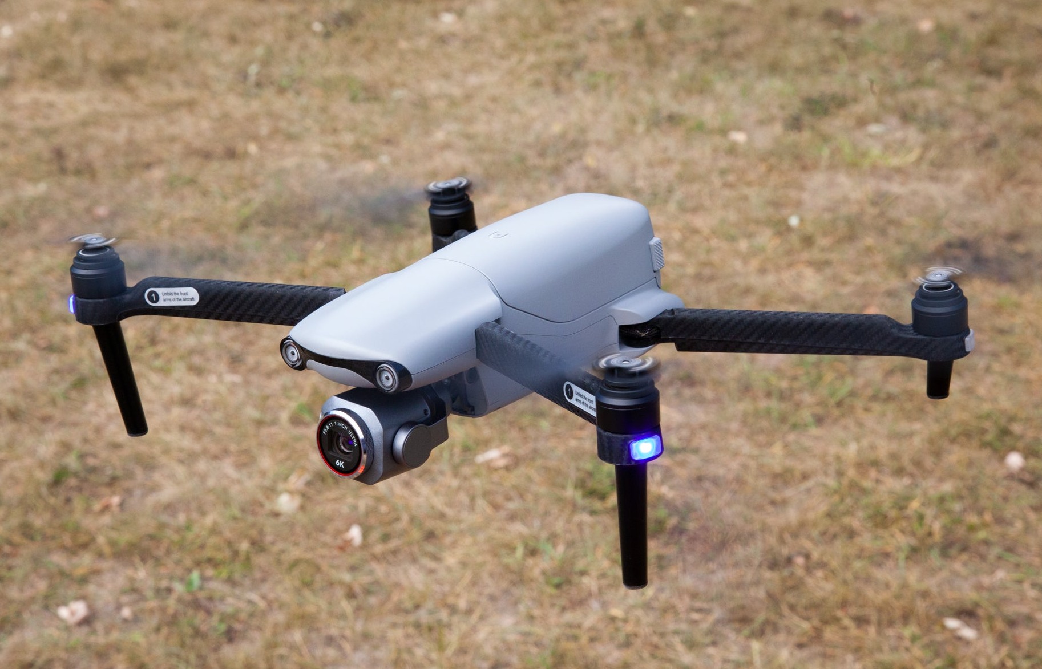
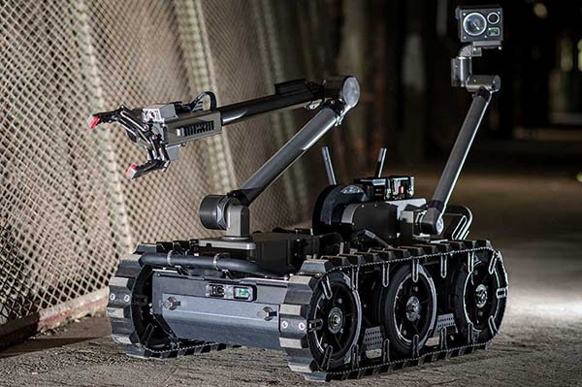
Evaluation of alternative solutions
Drones
Pros
Provide overhead views of environments, including inaccessible or elevated areas.
Already commercially available and supported by existing technology.
Cons
Hard to operate in enclosed areas
Requires significant skill from a trained operator
Ground Robots
Pros
Can have mobility in enclosed areas
A lot of them carry very sophisticated mapping and recording systems
Already being used by some first responders and military units
Cons
Mobility issues if the ground is obstructed/uneven
Usually large and hard to carry. Not very portable
Notes:
Drones
Pros
Provide overhead views of environments, including inaccessible or elevated areas.
It can be equipped with high-resolution cameras and thermal imaging.
Already commercially available and supported by existing technology.
No humans are put in harm's way
Cons
Hard to operate in enclosed areas
Requires significant skill from a trained operator
Not easily repairable
biggest drawback to drones is that they are very hard to place into rooms that are not easily accessible. Therefore, they are basically unusable in most scenarios that our product shines
Ground Robots
Pros
No humans are put in harm's way
Some have decent mobility
A lot of them carry very sophisticated mapping and recording systems (LIDAR, cameras, infrared)
Already being used by some first responders and military units
Cons
Mobility issues if the ground is obstructed/uneven
Usually large and hard to carry. Not very portable
Very costly to purchase and to maintain. Many of these are still in the prototype stage.

Slide 9
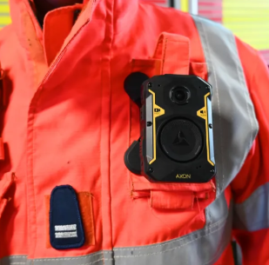
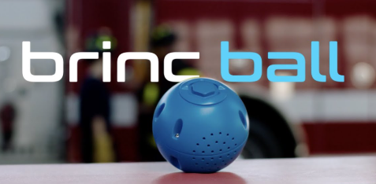
Evaluation of alternative solutions
Wearable Cameras for First
Responders
Pros
Portable, lightweight
High-quality streaming of real-time events
Cons
A human has to enter room to get the images
Only video streaming
Throwable Communication Ball
Pros
Portable, lightweight, durable
Connects first responders to civilians
Cons
Requires someone within the room to speak to
Only helps for audio, not for mapping environment
Notes:
Drones
Pros
Provide overhead views of environments, including inaccessible or elevated areas.
It can be equipped with high-resolution cameras and thermal imaging.
Already commercially available and supported by existing technology.
No humans are put in harm's way
Cons
Hard to operate in enclosed areas
Requires significant skill from a trained operator
Not easily repairable
biggest drawback to drones is that they are very hard to place into rooms that are not easily accessible. Therefore, they are basically unusable in most scenarios that our product shines
Ground Robots
Pros
No humans are put in harm's way
Some have decent mobility
A lot of them carry very sophisticated mapping and recording systems (LIDAR, cameras, infrared)
Already being used by some first responders and military units
Cons
Mobility issues if the ground is obstructed/uneven
Usually large and hard to carry. Not very portable
Very costly to purchase and to maintain. Many of these are still in the prototype stage.

Slide 10
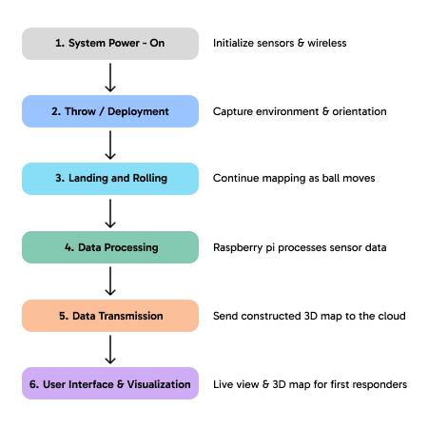
Proposed Design: Overview
A throwable ball containing cameras and electronics can be tossed into an environment
Once deployed, the ball captures wide-angle photos from each camera and transmits them to remote server via TAMU IoT
Once received by server, it synchronizes the data and performs 3D reconstruction via 3D Gaussian Splatting
Resulting 3D model sent to connected device for operator to inspect

Slide 11
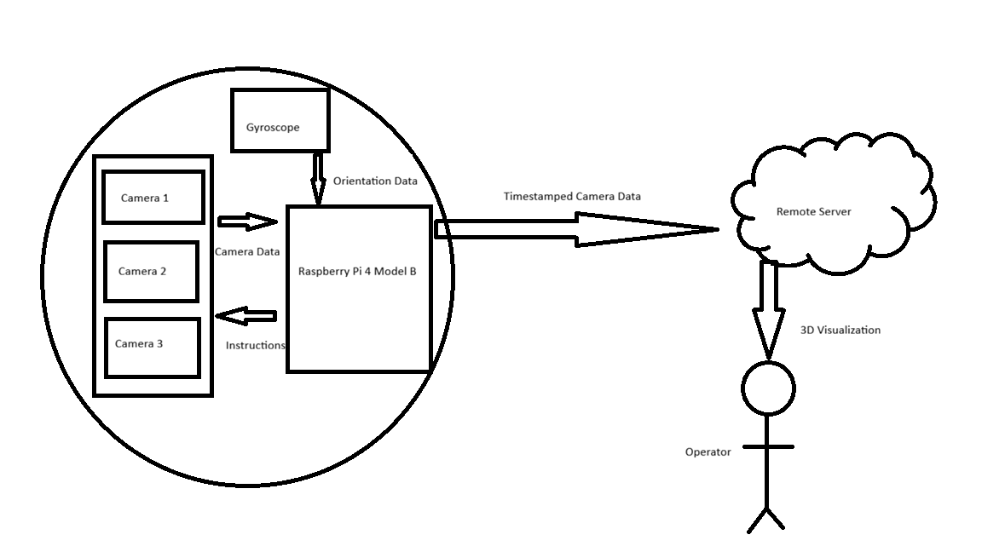
Proposed Design: Overview
Monitoring Unit

Slide 12
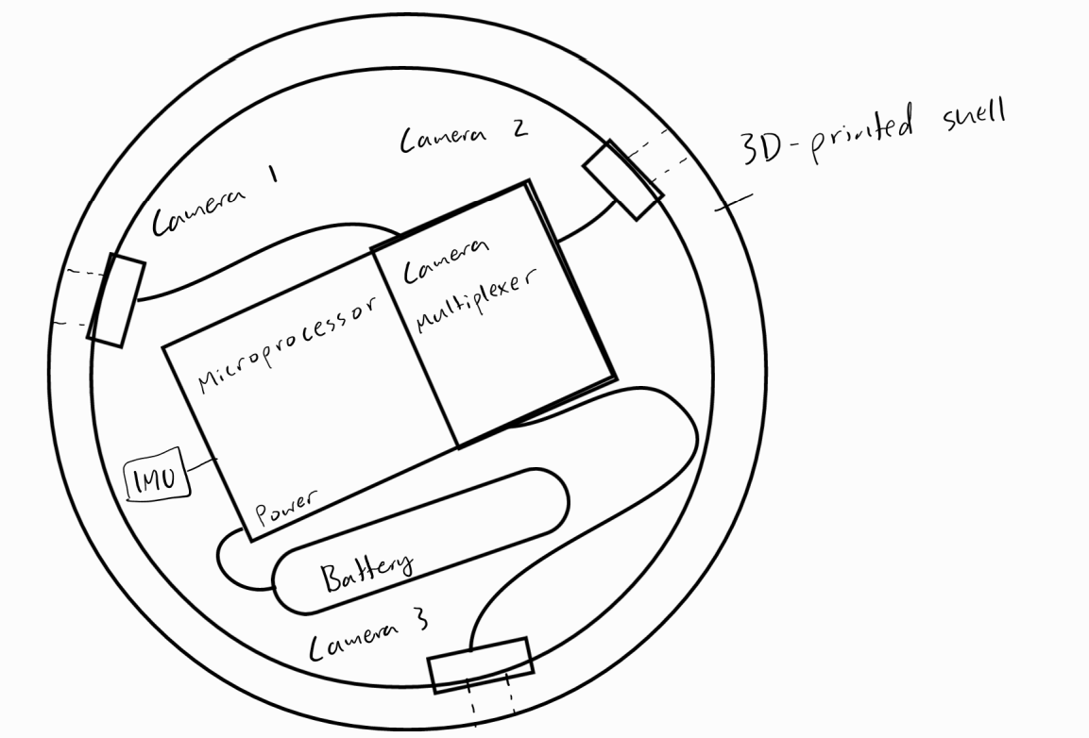
Hardware Design: Throwable Ball
Physical Shell: 3D-printed/CAD Design
(ABS filament for temperature resistance)
Components:
Raspberry Pi 4B microprocessor
Camera multiplexer
3 Camera modules
Portable USB battery bank
IMU Sensor (For camera-cut alg)
Overview
Cameras connected to Pi via Multiplexer
IMU Sensor connected to Pi
All components powered by a portable battery bank through the Pi
Cameras and Pi are mounted by screws
Battery→Pi (Initializing power source)
Raspberry Pi→Camera Multiplexer→Cameras

Slide 13
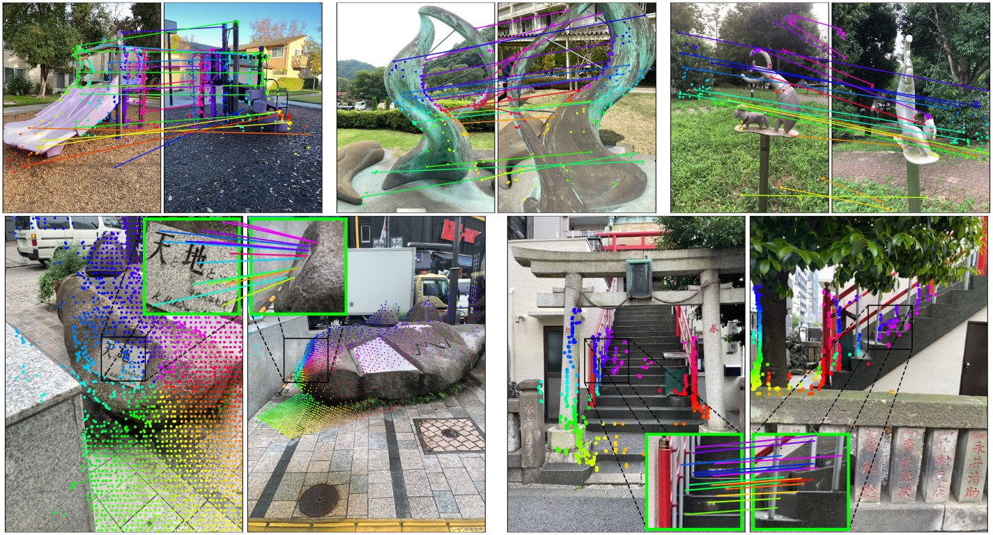
Software Design: Server Connection
Network Architecture
Tailscale VPN Mesh Networking
Secure encrypted tunnel between ball and server
Works across different physical Wi-Fi networks
Data Transmission
From Ball to Server
Synchronized camera frames (JPEG compressed)
IMU orientation data
Timestamps for frame alignment
HTTP Post via FastAPI endpoint
From Server to Operator
WebRTC streaming of rendered 3D model
Real-time visualization updates
Server process image
Ball
Remote Operator navigates 3D scene

Slide 14
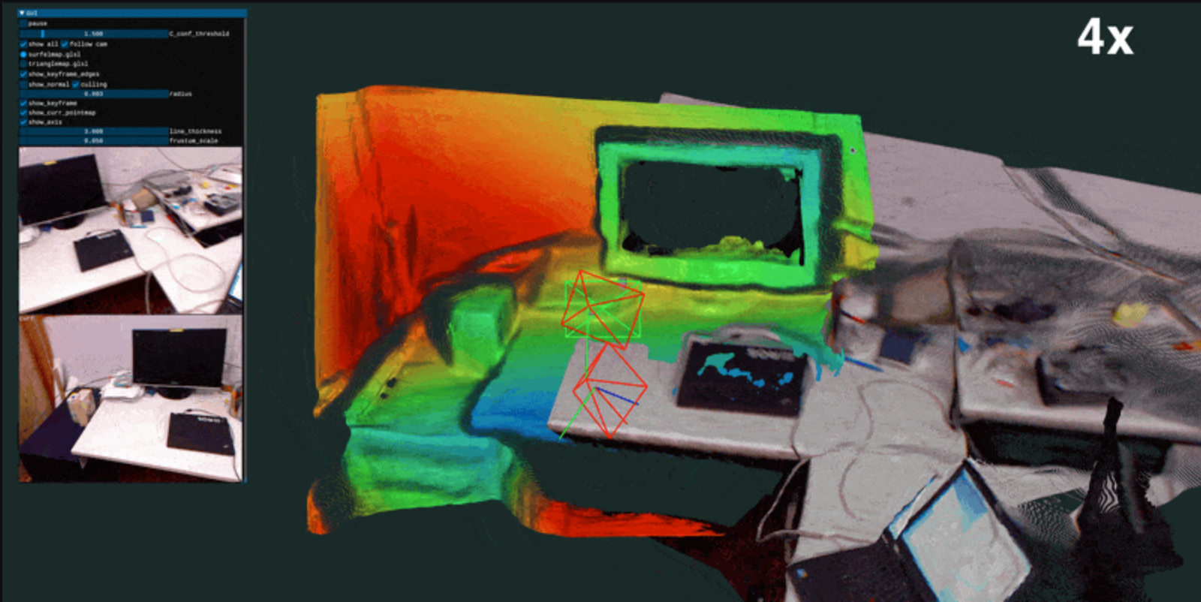
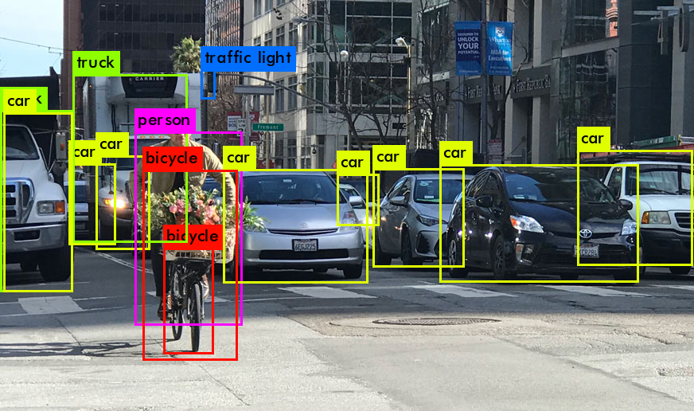
Software Design: SLAM + 3D-Mapping
Step 1: SLAM (Simultaneous Localization and Mapping)
Estimates camera position and orientation for each frame
Uses IMU data to improve pose estimation accuracy
Tracks ball’s trajectory through the environment
Step 2: 3D Gaussian Splatting
Reconstructs environment
Refines geometry based on SLAM-estimated camera poses
Generates photorealistic 3D scene
Step 3: Object Detection & Threat Identification
YOLO (You Only Look Once) based method
Flags moving objects
Server
Ball
Render image

Slide 16
Software Design: Camera Multiplexing
For most orientations, one camera will be pointing downwards, rendering it ineffective. We can disable the downward camera
Requires two components:
A gyroscope to determine orientation
A camera adapter to multiplex multiple cameras to one board
Reduces power consumption, wear on cameras, and points of failure

Slide 17
Approach for design validation
Camera Capture & Identification
Verify image accuracy by comparing console output to actual room layouts
Wireless Data Transmission
Test video and mapping streams through barriers up to 10 m for latency and data loss
User Interface & Display
Evaluate responsiveness and ease of use through operator trials and feedback
Durability & Impact Resistance
Perform repeated 10-ft drop tests; system must remain fully functional
Mapping & Decision Algorithms
Validate 3D model accuracy by benchmarking against real room measurements

Slide 18
Economic analysis and budget
Item | Quantity | Unit Cost (USD) | Total (USD)
Raspberry Pi 4 Model B, 1GB | 1 | 38.50 | 38.50
Raspberry Pi Camera Module 3 Wide | 3 | 37 | 111
Inertial Measurement Unit | 1 | 5 | 5
Anker Power Bank 5V/3A | 1 | 20 | 20
Multi Camera Adapter Module | 1 | 50 | 50
3D-printer filament (ABS, 1 kg) | 1 | 11 | 11
Solder | - | 5 | 5
Wire spool (22–24 AWG) | 1 | 3 | 3
Misc. fasteners, heat-shrink, etc. | - | ~5 | ~5
Estimated total |  |  | 248.50
Notes:
https://www.amazon.com/Anker-Travel-Ready-Technology-High-Speed-Output%EF%BC%88Black%EF%BC%89%EF%BC%8C1pack/dp/B0D5CLSMFB?sr=8-3

Slide 19
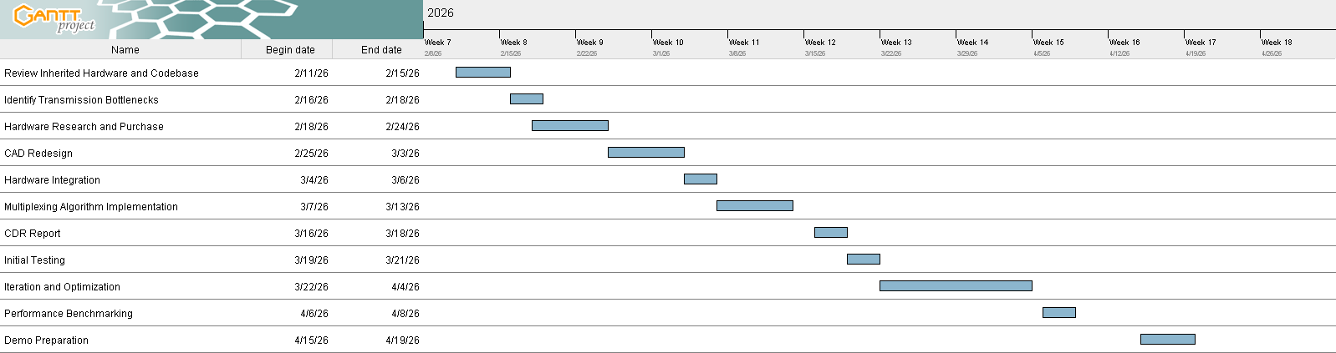
Schedule of tasks

Slide 20
Project management & teamwork
Hardware & CAD Designing
Antony & Kiet
>Antony: Team Lead
>Kiet: Finance & Purchases
Design inner mounting of cameras and pi board
CAD design for shell modification
Plan component connections
Physical debugging
Calculate capacity needs (power, etc)
Document hardware assembly procedures
Software
Brandon (Computer Vision & SLAM)
>System Design Architect
SLAM implementation
3D map generation + visualization
Object-detection implementation
Camera-cut algorithm
Hai Yen (Embedded Systems & UI)
>Testing Coordinator
User interface design
Sensor data processing
Sensor calibration
Josh (Networking & Streaming Design)
>Technical Reporting & Documentation
Real-time data processing
Backend API management
Camera feed synchronization

Slide 21
Project management & teamwork
General Responsibilities
Testing product via dropping, throwing, rolling
Debugging
Documentation
Personal notebook on general progress, thoughts, tasks
Documenting respective specialized role for other team members to use for referencing cross-dependency tasks and timeline
(Ex: Embedded Systems and Hardware team for debugging sensors feed)
Management
Weekly meetings and agenda for updating progress status and upcoming tasks
Primary communication: Discord with dedicated channels for hardware, software, testing, sharing useful links and notes
Task and progress tracking: Github for all coding documentation and changes, Spreadsheets for team’s overall task progress and individual tasks to ensure transparency

Slide 22
Societal, Safety & Environmental Analysis
Societal Impact
Enhances first responder safety and mission success in hazardous environments
Enables faster, more informed emergency decisions through real-time 3D situational awareness
Low cost and lack of need for training enables rapidly deployable safety at scale
Safety Considerations
Battery protection circuitry prevents electrical hazards such as overheating, overcharging, and short-circuiting
Remote operation capability limits direct human exposure to dangerous environments
Environmental Considerations
Compact 3D-printed shell minimizes the material waste and enables rapid prototyping
Energy-efficient electronics freduce power consumption and extend battery life

Slide 23
Questions?

Slide 24
THANK YOU

